Slide 1




Establishment of the agricultural advisory service in Ukraine
Roman Korinets
President of the National Association
of Agricultural Advisory Services of Ukraine
dpradaukraine@gmail.com
www.dorada.org.ua
TAIEX Workshop
Agricultural Advisory Services in the EU
Kyiv, 25-26 February 2016

Slide 2
Why agricultural advisory services are
important for Ukraine ?
Rural population (2014) - 14164,9 thousand people or 31,3% of total population.
Agricultural land - 42744,5 thousand ha.
The number of owners of land shares (stocks) - about 7 million persons, the average share of about 4 hectares.
The number of people employed in agriculture (2014) - 3577,5 thousand people or 17,5% of total
population.
Including hired workers - 659,9 thousand people
NUMBER OF AGRICULTURAL ENTERPRISES
 | as of July 1, 2013
Commercial companies | 8295
Private entities | 4153
Production cooperatives | 810
Farming enterprises | 40856
State-owned enterprises | 278
Enterprises of other
economic activity type | 1466
TAIEX Workshop
Agricultural Advisory Services in the EU
Kyiv, 25-26 February 2016

Slide 3
History in documents
The 90-ies of the ХХth century – The creation of the first services in the framework of international technical
assistance projects.
2001 - The concept of formation and development of a network of agricultural advisory services in Ukraine (Ministry of Agrarian Policy, Ukrainian Academy of Agrarian Sciences, the National Agrarian University).
2001 - the term «agricultural advisory service» was first used in the Law of Ukraine «On Stimulating the Development of Agriculture for the Period 2001-2004».
2002 - Preparation of proposals on improvement of the legal framework and the development of a network of agricultural advisory services by the Cabinet of Ministers of Ukraine was assigned to the priority provisions of the Programme of Ukraine's integration into the European Union in 2002.
June 17, 2004 – the Law of Ukraine «On Agricultural Advisory Activities».
2007 – National target program of agricultural advisory activities for the period until 2009.
2011 - The concept of the formation of the national system of agricultural extension.
2011 - Action Plan to implement the Concept of formation of the national system of agricultural advisory services for the period up to 2015.
TAIEX Workshop
Agricultural Advisory Services in the EU
Kyiv, 25-26 February 2016

Slide 4
The Law of Ukraine
«On Agricultural Advisory Activities»
Two main objectives of these activities were identified:
Improvement of the welfare of the rural population;
Development of the rural areas.
The Law defines the main tasks of these activities:
•raising knowledge level and improving practical skills of conducting profitable business;
providing economic entities and rural population with advisory services on economy,
technology, management, marketing, accounting, tax, legislation, ecology, and the like;
•Providing advisory services to executive bodies and local municipalities in the preparation and implementation of plans for socio-economic development, the formation of civil society;
•dissemination and implementation/commissioning of modern technologies, the latest achievements of science and technology;
fostering the development of non-agricultural businesses in rural areas, including rural green tourism, increase of rural population employment and the like;
•work with rural youth, initiation and implementation of youth programs;
other tasks as defined by law.
The marked objectives and tasks can be called universal: they cover all human activities in rural
areas. That is, in fact, we are talking about rural advisory services, and not just agricultural.
TAIEX Workshop
Agricultural Advisory Services in the EU
Kyiv, 25-26 February 2016

Slide 5
The Law of Ukraine
«On Agricultural Advisory Activities»
Basic methods of agricultural advisory work:
Training of producers and rural population;
Studies of the socio-economic problems of rural areas and
development of the options to address them;
Demonstration of forms and methods of economic entities; o Information support provided to business entities and rural population, and the like.
TAIEX Workshop
Agricultural Advisory Services in the EU
Kyiv, 25-26 February 2016

Slide 6
The Law of Ukraine
«On Agricultural Advisory Activities»
Subjects of agricultural advisory work:
consultants,
experts- consultants,
advisory services.
The law does not stipulate any restrictions in regards of organizational and legal form or ownership of agricultural advisory service.
TAIEX Workshop
Agricultural Advisory Services in the EU
Kyiv, 25-26 February 2016

Slide 7
The Law of Ukraine
«On Agricultural Advisory Activities»
The law establishes several mandatory requirements:
a legal person can call itself an advisory service, if it is registered in the Register of Advisory Services;
a legal person, wishing to be registered in the Register of Advisory Services, shall employ at least three consultants – physical persons, which are listed in the Register of Consultants;
a physical person, wishing to be registered in the Register of Consultants, shall undergo professional training, pass a qualification exam, obtain a qualification certificate.
TAIEX Workshop
Agricultural Advisory Services in the EU
Kyiv, 25-26 February 2016

Slide 8
The Law of Ukraine
«On Agricultural Advisory Activities»
The law provides that such activities may be carried out using:
the state and local budgets,
funds of economic entities,
grants, international technical assistance,
international programs and projects
donations of physical and legal persons,
other sources not prohibited by law.
TAIEX Workshop
Agricultural Advisory Services in the EU
Kyiv, 25-26 February 2016

Slide 9
The Law of Ukraine
«On Agricultural Advisory Activities»
The law stipulates:
In the National Budget of Ukraine for the relevant year there is a separate line stipulating allocation of funding for the national target program of agricultural advisory activities, providing socially-oriented advisory services.
In accordance with the programs of social and economic development local municipalities and local government administrations every year make special provisions in local budget drafts allocating funds for advisory activities.
National target programs, aimed at the development of agriculture and rural areas, provide for funding of advisory activities in the amount of not less than 5% of the funds allocated for these programs.
TAIEX Workshop
Agricultural Advisory Services in the EU
Kyiv, 25-26 February 2016

Slide 10
Excellent law –poor performance
Since the adoption of the law none of the national programs, aimed at the development of agriculture and rural areas, has provided for 5% of funding for advisory support.
  Since 2012 there has been no government support.
  Support by local budgets - the exception rather
than the rule.
  There are no real steps to create a public system of
agricultural extension
TAIEX Workshop
Agricultural Advisory Services in the EU
Kyiv, 25-26 February 2016

Slide 11
Reality
74 legal persons were registered in the Register of Agricultural Advisory Services and 1444 physical persons were registered in the Register of Agricultural Consultants and Experts- consultants.
    Certain services are fully operational with the support of international technical assistance projects or local budgets.
    All services are legal entities of exclusively private law.
    The amount of governmental support is no more than 2 million hryvnia per year, or 14 kopecks per rural resident.
    Budget funds are received by services erratically.
    There is a government's debt to services for services already rendered.
There is demand for services, but it is insolvent demand due to the poverty of the rural population.
TAIEX Workshop
Agricultural Advisory Services in the EU
Kyiv, 25-26 February 2016

Slide 12
Reality
Private advisory services (there are no public ones):
can not plan their activities in the face of uncertainty;
do not see their own perspectives;
tend to switch to other activities;
refuse to use the national budget funds;
terminate their activities.
In Ukraine, there is no system of agricultural extension, there are just its fragments, and the government is rather passive in regards of building such a system.
The main providers of idea: the National Association of Agricultural Advisory Services and our partners (Farmers' Association, the Union of Agricultural Cooperatives, Association of Rural and Village Councils), some universities.
TAIEX Workshop
Agricultural Advisory Services in the EU
Kyiv, 25-26 February 2016

Slide 13
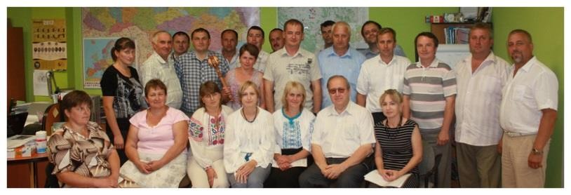
Working with faith in the future
Some results of the project «Improving the Competitiveness of the Dairy Sector in Ukraine» implemented by Lviv Agricultural Advisory Service (2008-2013), supported by the Government of Canada:
15 new family farms with livestock up to 2,752 cows were created ;
48 pastures were created on the area of 1152 ha;
a pasture area of 688 ha was improved;
the project participants - owners of cows- managed to increase milk production at their farms by 7,000 tons;
more than 800 workshops, visited by 17,000 people, were conducted;
more than 5,000 consultations were provided directly to farms;
a system of monthly reference information for each cow (5,000 cows) was introduced ;
a monthly laboratory evaluation of the quality of milk is implemented ;
a cooperative association «Ravnopraviye(Equality)» was founded.
TAIEX Workshop
Agricultural Advisory Services in the EU
Kyiv, 25-26 February 2016

Slide 14
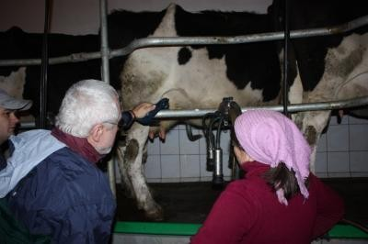
Expanding opportunities with faith in the future
Lviv Agricultural Advisory Service, Dnipropetrovsk Agricultural Advisory Service implement a new project «Development of the dairy business in Ukraine»:
The total budget - $ 27700000 Canadian dollars.
• Term - 7 years (2014-2021)
Direct beneficiaries - 5000 people
Indirect beneficiaries - 10,000
Financial Partners - Government of Canada - Ministry of Foreign Affairs, Trade and Development, Ecofund Danone in Ukraine, Danone Ukraine Foundation, Foundation «The Well-being of Communities» Dnipropetrovsk Regional State Administration, Lviv Regional State Administration.
TAIEX Workshop
Agricultural Advisory Services in the EU
Kyiv, 25-26 February 2016

Slide 15

Future
The Association Agreement between Ukraine and the EU
Article 404
Cooperation between the Parties in the field of agriculture and rural development will cover, inter alia, the following areas:
promoting mutual understanding of the policies in the field of agriculture and rural development;
strengthening the administrative capacity at central and local levels with respect to planning, evaluation and
implementation of policies;
promotion of modern and sustainable agricultural production, taking into account the need to protect the environment and animals, in particular the spread of the use of organic production methods and the use of biotechnology, among other things, by adopting the best practices in these areas;
exchange of knowledge and best practices on policies for rural development in order to promote economic well-being of rural communities;
improvement of the competitiveness of the agricultural sector, efficiency and transparency of the markets
and the conditions for investment;
dissemination of knowledge through training and information activities;
Promoting innovation through research and promotion of advisory services for agricultural producers;
greater harmonization on the issues discussed in the framework of international organizations;
i. exchange of best practices with respect to mechanisms to support policy in the field of agriculture and rural
development;
j. promotion of agricultural quality policy in the areas of product standards, requirements for production and quality schemes.
TAIEX Workshop
Agricultural Advisory Services in the EU
Kyiv, 25-26 February 2016

Slide 16
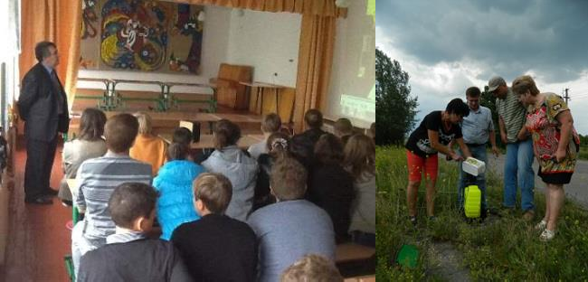
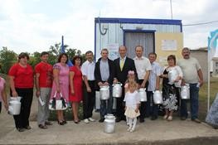
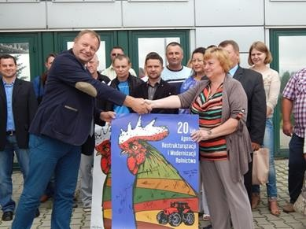
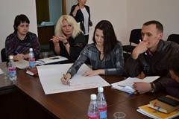
Future
Single comprehensive strategy for the development of agriculture and rural areas in the years 2015-2020 – being developed with the support of the EU
- as an example of efforts to find solutions:
Unsystematic provision of advisory services does not comply with the socio- economic needs of the society, the level of development of agricultural production and food security.
It is necessary to create a network of agricultural advisory services at provincial and district levels with offices in rural (village) councils.
TAIEX Workshop
Agricultural Advisory Services in the EU
Kyiv, 25-26 February 2016

Slide 17

Special opinion
In today's complex environment, the financial resources of the Ukrainian state are extremely limited. Despite the high importance of counseling for the development of agriculture and rural areas, it is hard to hope that the government will find resources for the creation of the public system of advisory services.
There is a need for an appropriate program of international technical assistance. It will be different from all previous programs due to the fact that it will focus not on the creation of separate counseling services, but on the formation of the public system of advisory services – i.e. entities and institutions - together with the state and with the participation of the state.
There are all preconditions for the success of such a program.
TAIEX Workshop
Agricultural Advisory Services in the EU
Kyiv, 25-26 February 2016

Slide 18
Thank you !
Welcome to cooperation!
The National Association of Agricultural Advisory Services of Ukraine
10 Geroyev Oborony street, office 10, Kiev, 03680, Ukraine
Mob.phone: +38 097 574-73-27
Е-mail: doradaukraine@gmail.com Skype: doradaua
Web-page: www.dorada.org.ua, www.facebook.com/adm.NAAASU, ww.youtube.com/user/doradaukraine/videos
TAIEX Workshop
Agricultural Advisory Services in the EU
Kyiv, 25-26 February 2016

