Slide 1

TAIEX Worskshop on Agricultural Extension Services in EU
Pecualiarities of legal regulation of the advisory services in EU Member States - Italy
25-26 February 2016
Kiev-Ukraine
Sonia Marongiu
CREA – Council for Agricultural Research and Agricultural Economics Analysis Rome
Unit: Policies and Bioeconomy

Slide 2


CRA
Council for Agricultural Research
INEA
National Institute of Agricultural Economics
CREA – Council for Agricultural Research and Agricultural Economics Analysis born in 2015 as a merge of CRA and INEA, two agencies that operated under the supervision of the Ministry of Agricultural, Food and Forestry Policies.
The objective of the reorganization is to have a better coordination and optimization of administrative, economic and organizational efforts done to promote the Italian agriculture and agri-food industry. CREA consists of 12 centres:
6 related to specific areas: genomics and bioinformatics; agriculture and environment; protection and certification; agricultural engineering and processing; food and nutrition; policies and bioeconomy
6 related to the supply chain: crops and industrial crops; arboriculture; viticulture and enology; horticulture and floriculture; animal husbandry and aquaculture; forests and wood products.
http://sito.entecra.it/portale/index2.php

Slide 3

Structural characteristics of Agricultural Sector in Italy (1)
Agriculture Census 2010
17.1 millions ha = total agricultural area
12.9 millions ha=utilized agricultural area
1.6 millions of agricultural holdings
1.2 ha under organic agricultural management (40,146 holdings)
Average farm size : 7.9 ha
14.4 ha North; 5,1 ha in South
Differences Census 2000-2010
- Farm numbers
+ Farm size
Italy is characterized by a high diversity in farming systems:
Heterogeneity of climatic and soil conditions (hilly land 41.6%; mountainous 35,2%; lowland 23,2%)
Differences in local institutional arrangements (agriculture managed at a Regional level)
Different market opportunities: traditional agricultural commodities + non agricultural commodities (agritourism, education, green energy, pluriactivity, etc.); public goods.
Socio-economic factors
Differences in performance and profitability (net income ranges from 41,000 € in NW to 15,000 € in South)
High percentage of non-enterprise farms (36%) producing for self-consumption. 96% of farms are individual or family farms.

Slide 4
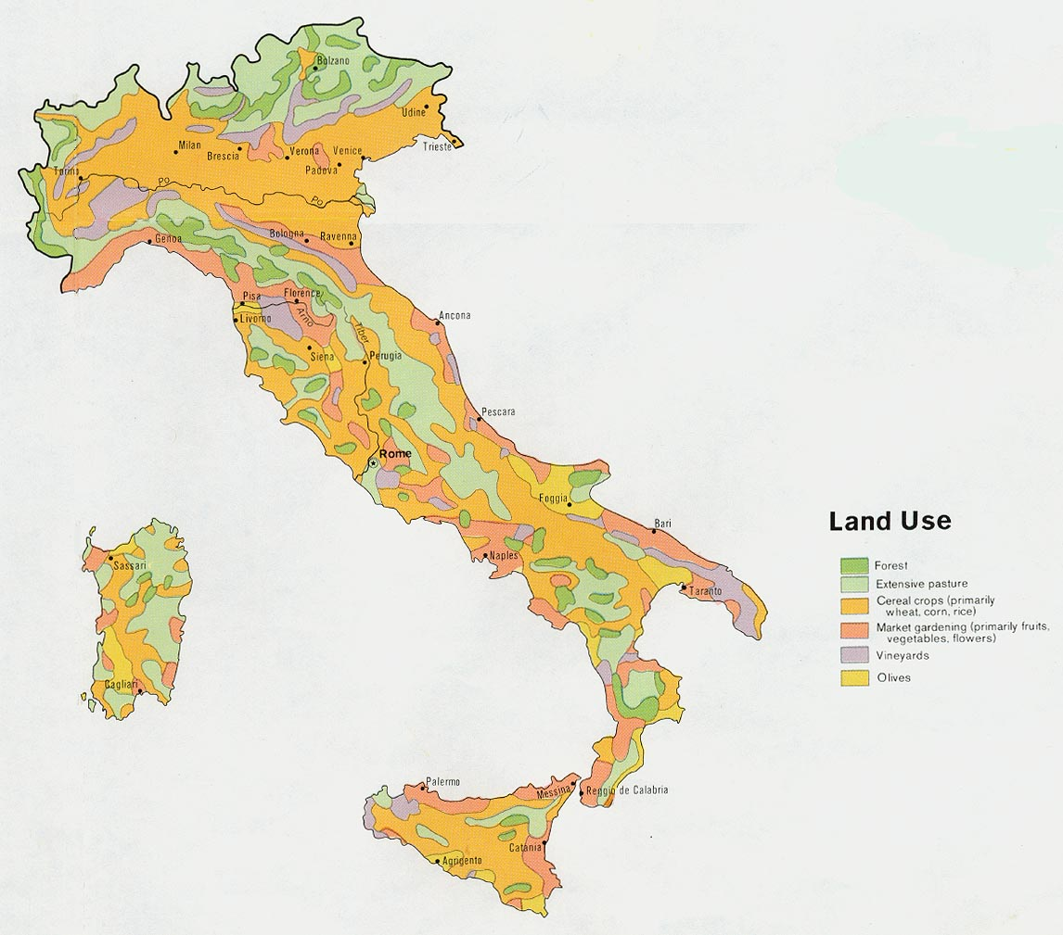
Structural characteristics of Agricultural Sector in Italy (2)
Problem: ageing farm population
10% of total holders have less than 40 years
60% above 55 years
38% above 65 years
Environmental indicators:
15% of Italian farms and 24% of total UAA are considered as High Nature Value Farming Systems (OECD classification)
High multifunctionality of agriculture
It is becoming crucial to promote sustainable local development within a new conception of the rural-urban relationships (the traditional definitions do not capture the complexity of land use in Italy).
Arable crops (54.5% of total UAA)
Permanent grassland and pastures (26,7%)
Permanent crops: olive, vines, fruit (18,5%)
Objectives of regional agricultural policy and the needs of agricultural advisory services are differentiated in the whole territory

Slide 5
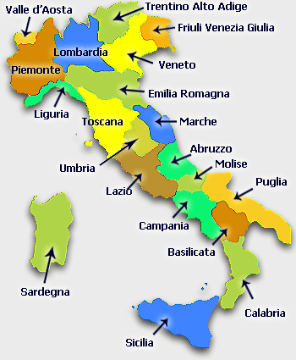
Characteristics of the Italian Advisory Services System
As stated, Italy is a very complex country, with different territorial characteristics and governance. More specifically, following the decentralization process (DPR 616/77 and 617/77), agriculture is subject to the jurisdiction of 19 Regions and 2 Autonomous Provinces (Trento and Bolzano).
Every Region has a Department of Agriculture → its own organization of Advisory Services → its own specific Agricultural Knowledge System (AKS)
AKS organization and competences
R&D policies: State and Regions
Higher education: State
Vocational Education: Regions
Extension and Advisory Services: Regions
In every Region the AS system includes 3 components:
Public
Private
Farmers associations

Slide 6
FAS Regulations in Italy
1979 | 1989-1993 | 1994-1999 | 2000-2006 | 2007-2013 | 2014-2020
Reg. (EEC) 270/79 co-financed initiative aimed to train experts to carry out agricultural advisory service
Multi Regional Operative Programmes: Reg. (EEC) 2052/88 and followed: promotion of new AS procedures aiming at connecting innovation and knowledge with local needs of training and advice
Decentralized organizational model: every Region has its law.
Differente service’s providers.
Research, advisory, training, dissemination have not a single legislative framework but all is managed by Regional Agencies and bodies.
Rarely the AS were used for the implementation of development policies. Something is changing since FAS is included in RDP.
Decreasing of funds for advisory services (one half comparing to the previous years): first attempt to restructure the sector (more competitions) and making the farmers pay a part of the costs. CAP Reform: Reg. (EC) 1782/2003 and 1783/2003
Reg. (EC) 1698/2005: FAS realized in RDP (Measures 114 and 115)
Reg.(UE) 1305/2013 and 1306/2013 in the next RD programming period 2014-2020 (Measure 2)

Slide 7
Regional law, tipology and organizational model of Advisory in Italy
 |  |  | Typology |  |  |  | Organizational model
 | Law |  | Advisory | Training | Research |  | Centralized |  | Selection | Help desk |  | Monitoring/evaluation
Piemonte | n. 17 del 08/07/1999 |  | X | X | X |  | - |  | - | X |  | X
Valle d'Aosta | - |  | - | - | - |  | X |  | - | - |  | -
Lombardia | n. 31 del 05/12/2008 |  | X | X | X |  |  |  | X | - |  | X
P.A. Bolzano | n. 53 del 03/11/1975 |  | - |  | X |  | X |  | - | - |  | X
P.A. Trento | n. 14 del 02/08/2005 |  | - | X | X |  | - |  | X | X |  | X
Veneto | n. 32 del 09/08/1999 |  | X | X | X |  | - |  | X | X |  | X
 | n. 21 del 16/11/2000 |  | X | X | X |  | - |  | X | X |  | X
Friuli Venezia Giulia | n. 005 del 23/02/2006 |  | X | X | X |  | - |  | X |  |  | X
Liguria | n. 22 del 29/11/2004 |  | X | X | X |  | - |  | X | X |  | X
Emilia-Romagna | n. 28 del 11/08/1998 |  | X | X | X |  | - |  | X | - |  | X
Toscana | n. 34 del 03/08/2001 |  | X | X | X |  | - |  | X | - |  | X
 | n. 02 del 09/01/2009 |  | X | X | X |  | - |  | X | - |  | X
Umbria | n. 33 del 17/12/2002 |  | X | X | X |  | - |  | X | - |  | X
Marche | n. 37 del 23/12/1999 |  | X | X | X |  | - |  | X | - |  | X
Lazio | n. 56 del 12/12/1987 |  | X | X | X |  | - |  | X | - |  | X
 | n. 15 del 13/06/2003 |  | X | X | X |  | - |  | - | X |  | X
Abruzzo | n. 66 del 06/09/1999 |  | X |  |  |  | - |  | - | X |  | X
 | n. 37 del 28/11/2005 |  | X | X | X |  | - |  | X | X |  | X
Molise | n. 22 del 21/11/1988 |  | X | X | X |  | - |  | X | - |  | X
Campania | n. 07 del 03/01/1985 |  | X | X | X |  | - |  | X | - |  | X
 | n. 08 del 28/03/2000 |  | X | X | X |  | - |  | X | - |  | X
Puglia | n. 8 del 8/02/1994 |  | X | X | X |  | X |  | - | X |  | X
Basilicata | n. 29 del 16/08/2001 |  | X | X | X |  | - |  | X | X |  | X
Calabria | n. 19 del 26/07/1999 |  | X | X | X |  | - |  | - | X |  | X
Sicilia | n. 73 del 1/08/1977 |  | X | - | - |  | - |  | - | -
 | n. 32 del 23/12/2000, art. 135 |  | - | - | X |  | - |  | X | X |  | X
 | n. 20 del 22/12/2005, art. 5 |  | - | - | X |  | - |  | X | X |  | X
Sardegna | n. 13 del 08/08/2006 |  | X | X | X |  | - |  | - | X |  | X

Slide 8
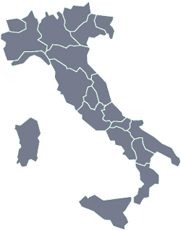
Council Regulation (EEC) 270/79: the milestone (1)
The actual structure of FAS in Italy is influenced by the Council Regulation (EEC) 270/79 of 6 February 1979 on the development of agricultural advisory services in Italy:
Included within the so-called Mediterranean Package
Sustained the development of FAS in Italy thanks to 66 millions ECUs distributed over 12 years.
Regulation 270/79 intended to train and employ 3,000 extension agents (60% in South and Island).
Common framework defined by the implementation plan of the national CIDA (Interregional Committee for Agricultural Advisory).
5 Centres for agricultural training: CIFDA (Interregional Training Center for Agricultural Advisory)
Every Region had to establish its own regional law on advisory services which defined their organisations, actors and subjects.
21 Regional laws

Slide 9
Council Regulation (EEC) 270/79: the milestone (2)
Regulation 270/79 intended train professional experts with the right competences in the field of specialized agriculture but also diversification. The main concern was recognizing the importance of innovation in agriculture in the framework of Common Agricultural Policy.
National Plan for Advisory Services
Managed by the CIDA
Avisors are trained in 5 CIFDA
1 in north Italy
1 in Centre Italy
2 in South Italy
1 in Island
Over the years, each Region has followed its own path in the organization of agricultural advisory services. The result is a territorial heterogeneity in the delivery of services (quantitative and qualitative) which leaves open the debate about the real effectiveness of the governance mechanisms associated to decentralization.
European Commission gave funds for the management of CIDA, to train the advisors and to provide advisory services to farms.
Regulation 270/79 ended at the end of 90s.

Slide 10
What happened after Reg. 270/79?
After Reg. 270/79, the agricultural advisory services have been supported by the Multiregional Operating Programmes (EEC Regulation 2052/88 and followed 1989-1993, 1994-1999).
In 2000s, the advisory services in Italy where supplied by
Private bodies (50%) and public institutions (50%) in Northern and Central Regions
Private bodies (36%) and public institutions (64%) in Southern Regions.
From 2000 to 2006 there has been a strong reduction of the investment in extension services (and advisory services) due to the cut of European Funds. Some projects were carried out at a National Level as the Interregional Programme for agricultural and rural development advisory services coordinated by INEA
Aims: Promote networking and share debates about advisory services (especialy contents and methods), to test new tools and approaches, to disseminate the best practices.
New trends in the Italian AAS:
Pluralism and privatizations: other farm based organization and private advisors increased their importance thanks to the adoption of public procedures of selection
Partecipation of farmers in funding and planning the public advisory services

Slide 11
Regulation (EC) 1782/2003 and Rural Development Plan 2007-2013 (1)
Farm Advisory Services in Italy experienced a new attention in the contest of the Mid Term Review of CAP in 2003 (key innovations: decoupling and cross-compliance) and in the RD plans 2007-2013.
Artt. 13-16 of Reg. (EC) 1782/2003 (establishing common rules for direct support scheme payments) asked to Memeber States to create a FAS as a support to the implementation of cross compliance, that is few rules consistent in «statutory management requirements» (SMR) and some «good agricultural and environmental conditions» (GAEC).
Measures to support FAS have been introduced in the Reg. (EC) 1698/2005 on support for RD and included in Axis 1 (improving competitiveness)
Measure 114 – Use of agricultural and forest advisory services
Measure 115 – Setting up of farm advisory services (in few Regions)
Measure 111 - Vocational training and information actions (considered complementary: in some Italian Regions it has been applied together with Measure 114)
→ Vocational training, information and advisory to improve the farmer’s knowledge and satisfy the agricultural/forestry farm needs.
Concering M114, there were 17+1 different schemes with different combinations of Measures and interventions. 3 Regions (Trento, Bolzano and Friuli Venezia Giulia) did not apply for M114.

Slide 12
Measure 114 - Rural Development Plan 2007-2013 (s)
Measure 114 – Use of agricultural and forest advisory services
Cross compliance is the compulsory requirement while the improvement of the whole performance is an optional action*
Beneficiaries: agricultural and forest farmers (some regions adopting priorities)**
Total amount: until 80% of expenses (maximum 1,500 € for advice except in Sicily) and 20% payd by the farmers
Advisors: authorities and private bodies but not single people (except in Emilia Romagna). The bodies have to received qualification by demonstrating their competence and reliability.
It has been activated in 18 Regions (no in the Autonomous Province of Trento , Friuli Venezia Giulia and Valle d’Aosta).
* 2 levels of advisory
Basic advisory services: cross compliance and work safety
Advanced advisory services: cross compliance, work safety, farm management, marketing, associationism, innovation.
** Many Regions have adopted priorities for the choice of farmers: the farm is set in Nitrate vulnerable zones; the farmers have finalized programs as environmental issues, animal pathologies, cultivation methods and breeding for animal health and werlfare, etc..

Slide 13
Measure 114 - Rural Development Plan 2007-2013 (s)
Priority criteria to access to funding for Measure 114 | High (>10 regions) | Medium (5<10 regions) | Low (0<5 regions)
Farms wit less than 10/15,000 € of direct payments |  | X
Young farmers/Women | X
Farms located in Nitrate Vulnerable Zones |  | X
Farms in less favoured areas |  | X
Farms in specific sectors (organic, livestock farming, fruit, etc.) |  | X
Farmers partecipaing to specific regional programms |  |  | X
Farms partecipating in quality schemes or other measures |  | X
Professional farmers |  | X
Farmers involved in integrated advisory services |  |  | X
Farms in Nature 2000 areas |  | X

Slide 14
Measure 114 - Rural Development Plan 2007-2013
The methods used to provide advice to livestock farmers are the classical methods applied for extension services:
One to one on the farm (mainly)
Small group advice on the farm
Small group advice outside the farm
Publications
Problems faced during the organisation and management of FAS
Need of empowering the network of the different advisory bodies and training advisors
High costs concerning bureaucracy and controls
Difficulties in monitoring the efficiency and effectiveness of FAS implementation
Exclusion of private entities: legal problems at the beginning of programming period
Limitation in the contents of advice: following the EU indication, FAS have to cover mainly cross compliance while the farmers required advices for a broad spectrum of activities (improvement of global output, innovation, farm diversification, etc.).

Slide 15
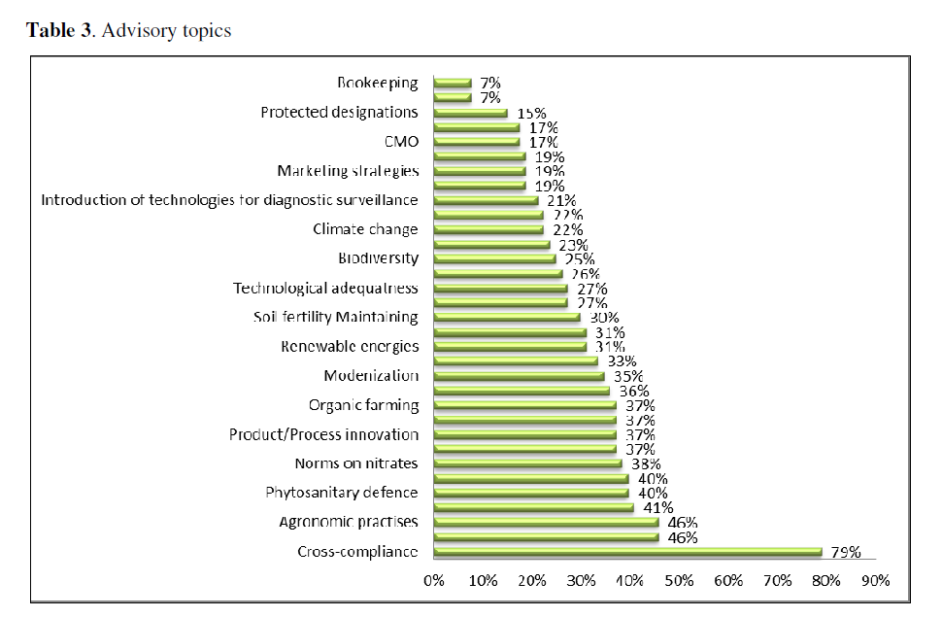
Measure 114 - Rural Development Plan 2007-2013
Results of a research made during 2007-2013 period on a sample of advisors in all Italy
Cross compliance, food safety, HACCP, agronomic practices and the standards to be met to obtain the prize CAP are still the most requested by the farmers.

Slide 16
Regulation (EU) 1306/2013 and the Rural Development Plan 2014-2020
Title III (artt.12-14) of Regulation (EU) 1306/2013 on the financing, management and monitoring of Common Agricultural Policy establishes in all the Member States a system for advising beneficiaries on land management and farm management (FAS).
FAS shall be operated by designated public bodies or selected private bodies.
Advisory services shall cover the following arguments:
Obligations resulting from the statutory management requirements and the standards for food agricultural and environmental condition of land
Agricultural practices beneficial for climate and environment and maintenance of agricultural areas
Farm modernization, competitiveness, building, sectoral integration, innovation, market orientation, promotion of entrepreneurship
Promotion of conversions of farms, diversification, risk management . Climate change mitigation and adaptation, biodiversity and protection of water.
A very broad spectrum of activities can be included in FAS in the next programming period.
Art.15 Regulation (UE) 1305/2013
Advisory Services, farm management and farm relief services

Slide 17
Advisory Services in the Rural Development Plan 2014-2020
What’s news?
During 2007-2013 programming period the use and setting up of advisory services were already supported but under two different Measures (114 and 115). The new regulation introduced a simplification merging them in a single one.
The new Measure includes the training of advisors to ensure the quality and the relevance to the advice provided.
The beneficiaries shall be chosen through calls for tenders, governed by public procurement law, open to public and private bodies.
The limitation on the frequency of use of the advisory services has been removed in order to allow farmers to use the service according to their needs.
Objectives: improve the sustainable management and the economic and environmental permormance of farm, forest holdings ans SMEs operating in rural areas.
It contributes to Priority 1 «Fostering innovation, cooperation and the development of the knowledge base in rural areas» but it can be considered a horizontal measure, relevant for all of priorities for RD.
As in the past, in Italy there are different applications in every Region. All the Rural Development Plans have implemented the new Measure for the next programming period following the indication of the Measure fiche. Guidelines have been issued by Mipaaf to coordinate the intervention at national level.
Notes:
in rural areas.

Slide 18
Conclusions
The funds for FAS provided by the Regulation 1698/2005 supported farmers to implement cross-compliance (reducing environmental impact and soil erosion, improving the animal well-being, the food safety and the labour safety). FAS → linked to a specific political aim.
Following EU Reg. 1698/2005, funds must help farmers and forest holder to meet costs arising from the use of AS to improve the overall performance. FAS → linked to activities and instruments improving the competitiveness.
Defining specific measures on FAS in the RDP could assure access to advisors and knowledges for all the farmers and subjects operating in rural areas. This can be more effective and efficient.
The source of information and the knowledge needs of farmers are increased during the time, became more complex.
The committment of the public institution is not continuous since it is conditioned by the availability of European Funds, especially the Rural Development Funds. For example: in 2000-2006 the EU policy neglected the advisory services and many Regions did not replace these funds, assuring only the functioning of the public structures and basic services.
There is not a regular flow of resources to the system, especially with regard the management and the organization of the specialized advisors
The decentralization has dispersed administrative and political responsabilities among different levels of authorities and this is resulted in a fragmented system.
FAS could have point of view broader respect to those required by the RD policies (2007-2013 period)

